Slide 1
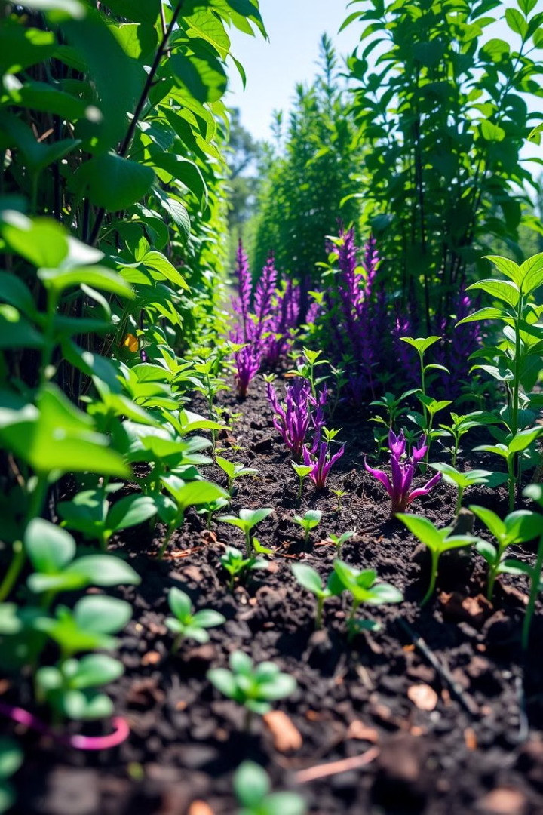

Detection of Soil Moisture using Raspberry Pi* with C++
This project explores the use of a Raspberry Pi and a soil moisture sensor to create a reliable and cost-effective system for monitoring soil moisture levels in a garden or agricultural setting. By leveraging the power of C++ programming, the system can provide real-time data and insights to support efficient water management.
by Syed Ibrahim & I. Chandra Balaji Surya

Slide 2

Introduction to Soil Moisture Monitoring
1
Importance of Soil Moisture
2
Benefits of Automated Monitoring
3
Challenges of Manual Monitoring
Maintaining optimal soil moisture is crucial for plant health, water conservation, and efficient irrigation practices.
Real-time data can help gardeners and farmers make informed decisions about watering schedules and soil conditions.
Traditional methods of manually checking soil moisture can be time-consuming and prone to inconsistencies.

Slide 3
Hardware Components: Raspberry Pi and Soil Moisture Sensor
Raspberry Pi
Soil Moisture Sensor
Connectivity
A compact, powerful, and versatile single-board computer that serves as the brain of the system.
A sensor that measures the volumetric water content in soil, providing the necessary data for the system.
The Raspberry Pi and sensor are connected using GPIO pins, enabling real-time data acquisition and processing.

Slide 4
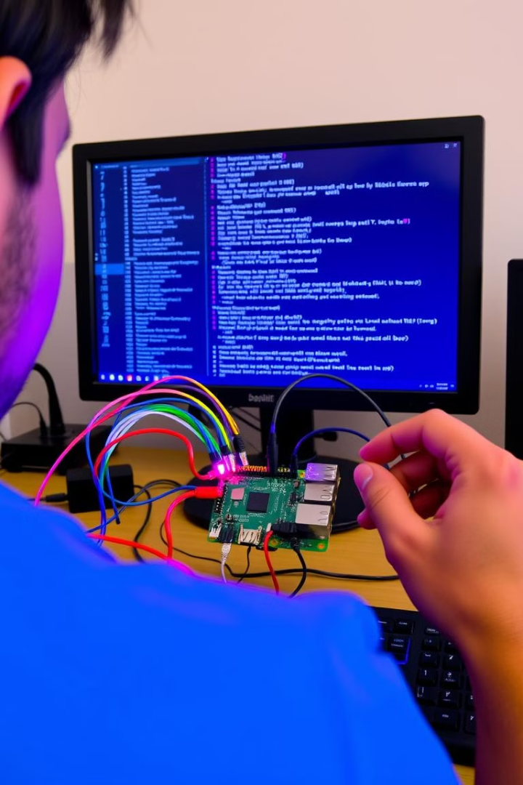
Raspberry Pi Software Setup and Configuration
1
Operating System
Install a compatible Raspberry Pi operating system, such as Raspberry Pi OS, to provide a stable and secure platform.
2
Sensor Drivers
Configure the necessary drivers and libraries to interface the soil moisture sensor with the Raspberry Pi.
3
Networking
Set up a network connection to enable remote access, data logging, and potential cloud integration.

Slide 5
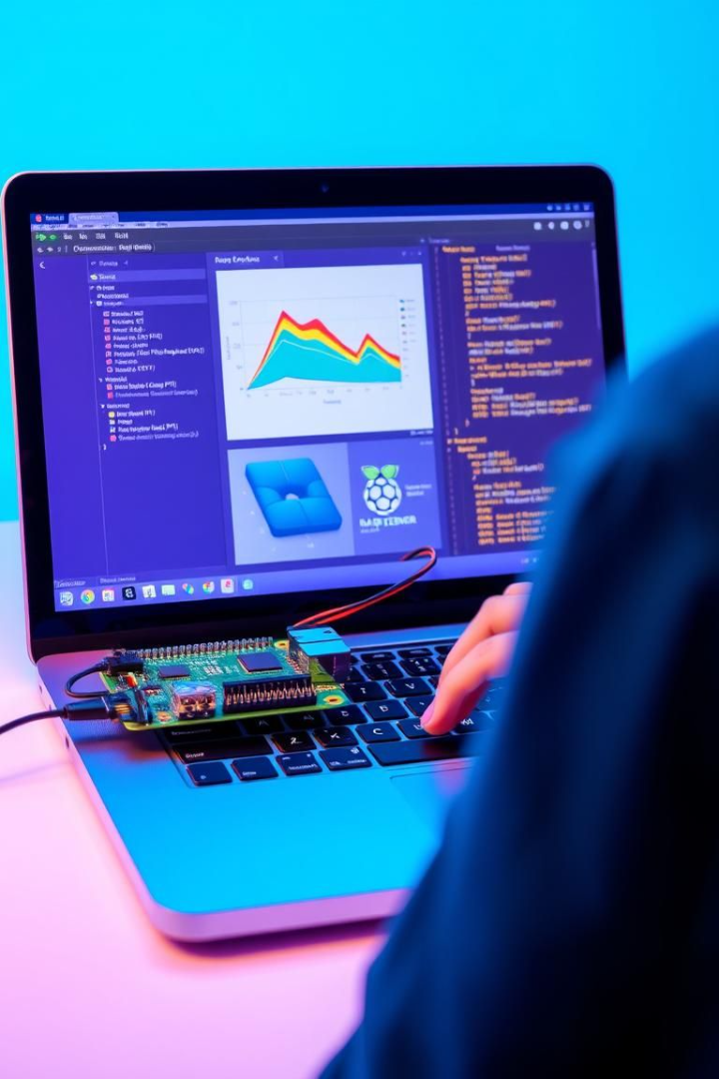
C++ Programming for Soil Moisture Detection
Sensor Integration
Data Processing
Write C++ code to read and interpret the sensor data, converting raw values into meaningful moisture measurements.
Implement algorithms to analyze the sensor data, detect trends, and trigger alerts based on predefined thresholds.
Automation
Logging and Reporting
Develop automated routines to control irrigation systems or provide recommendations for optimal watering schedules.
Store the sensor data and generate reports for historical analysis and decision-making purposes.

Slide 6




Data Acquisition and Processing
Data Collection
Data Processing
Decision-Making
The Raspberry Pi continuously reads and records the soil moisture sensor data at regular intervals.
The collected data is analyzed to identify trends, patterns, and any significant changes in soil moisture levels.
The processed data is used to make informed decisions about irrigation schedules and soil management strategies.

Slide 7
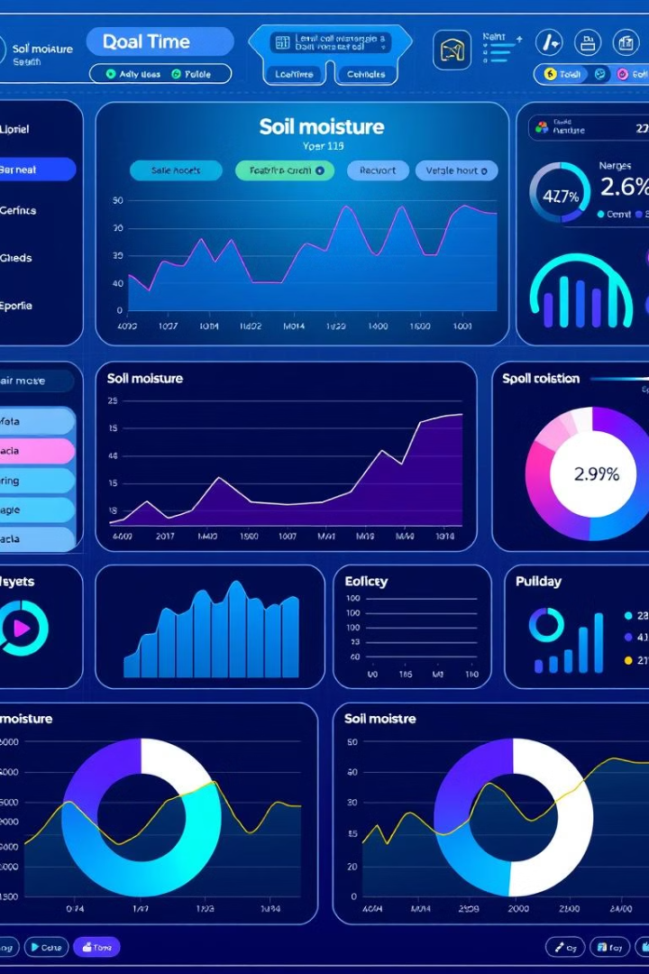




Visualizing Soil Moisture Data
Trend Analysis
Comparative Analysis
Visualize soil moisture data over time to identify long-term trends and patterns.
Compare soil moisture levels across different locations or time periods for comprehensive insights.
Thresholding
Data Reporting
Set custom thresholds to trigger alerts when soil moisture levels fall outside the desired range.
Generate detailed reports to share findings and support decision-making processes.

Slide 8

Conclusion and Future Enhancements
The Raspberry Pi-based soil moisture detection system provides a reliable and cost-effective solution for monitoring and managing soil moisture levels. By integrating C++ programming, this project offers a versatile platform for data acquisition, processing, and visualization, empowering gardeners and farmers to make informed decisions and optimize their water usage.
Future enhancements may include integration with IoT (Internet of Things) platforms, remote access and monitoring capabilities, and the incorporation of machine learning algorithms for predictive analysis and automated irrigation control.

Slide 9
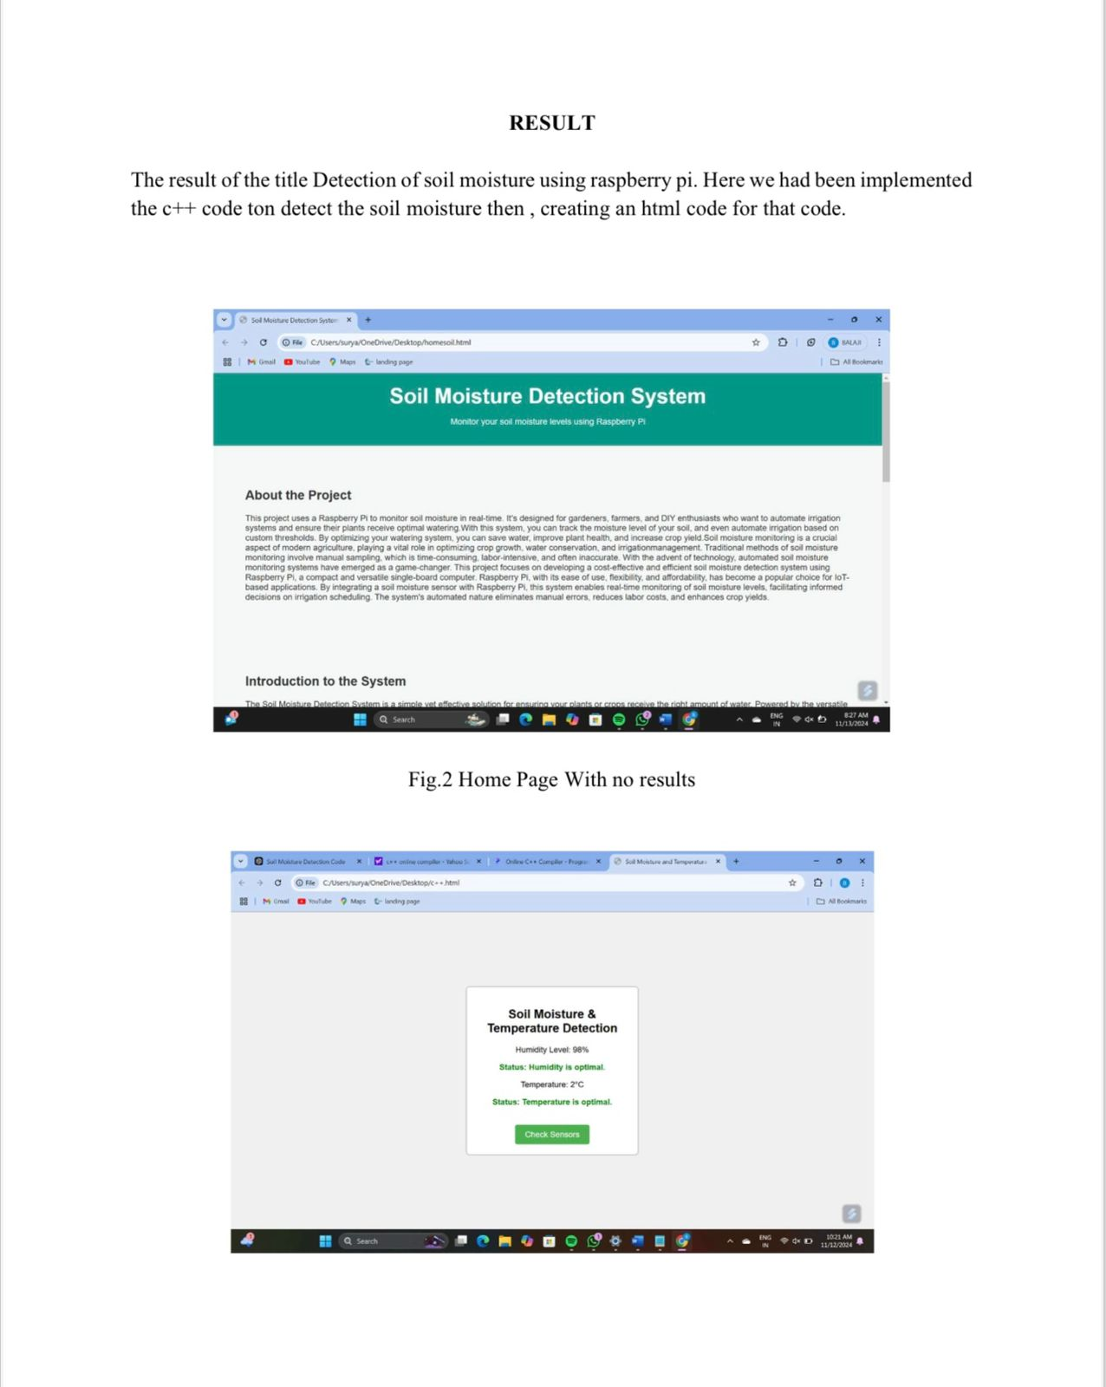
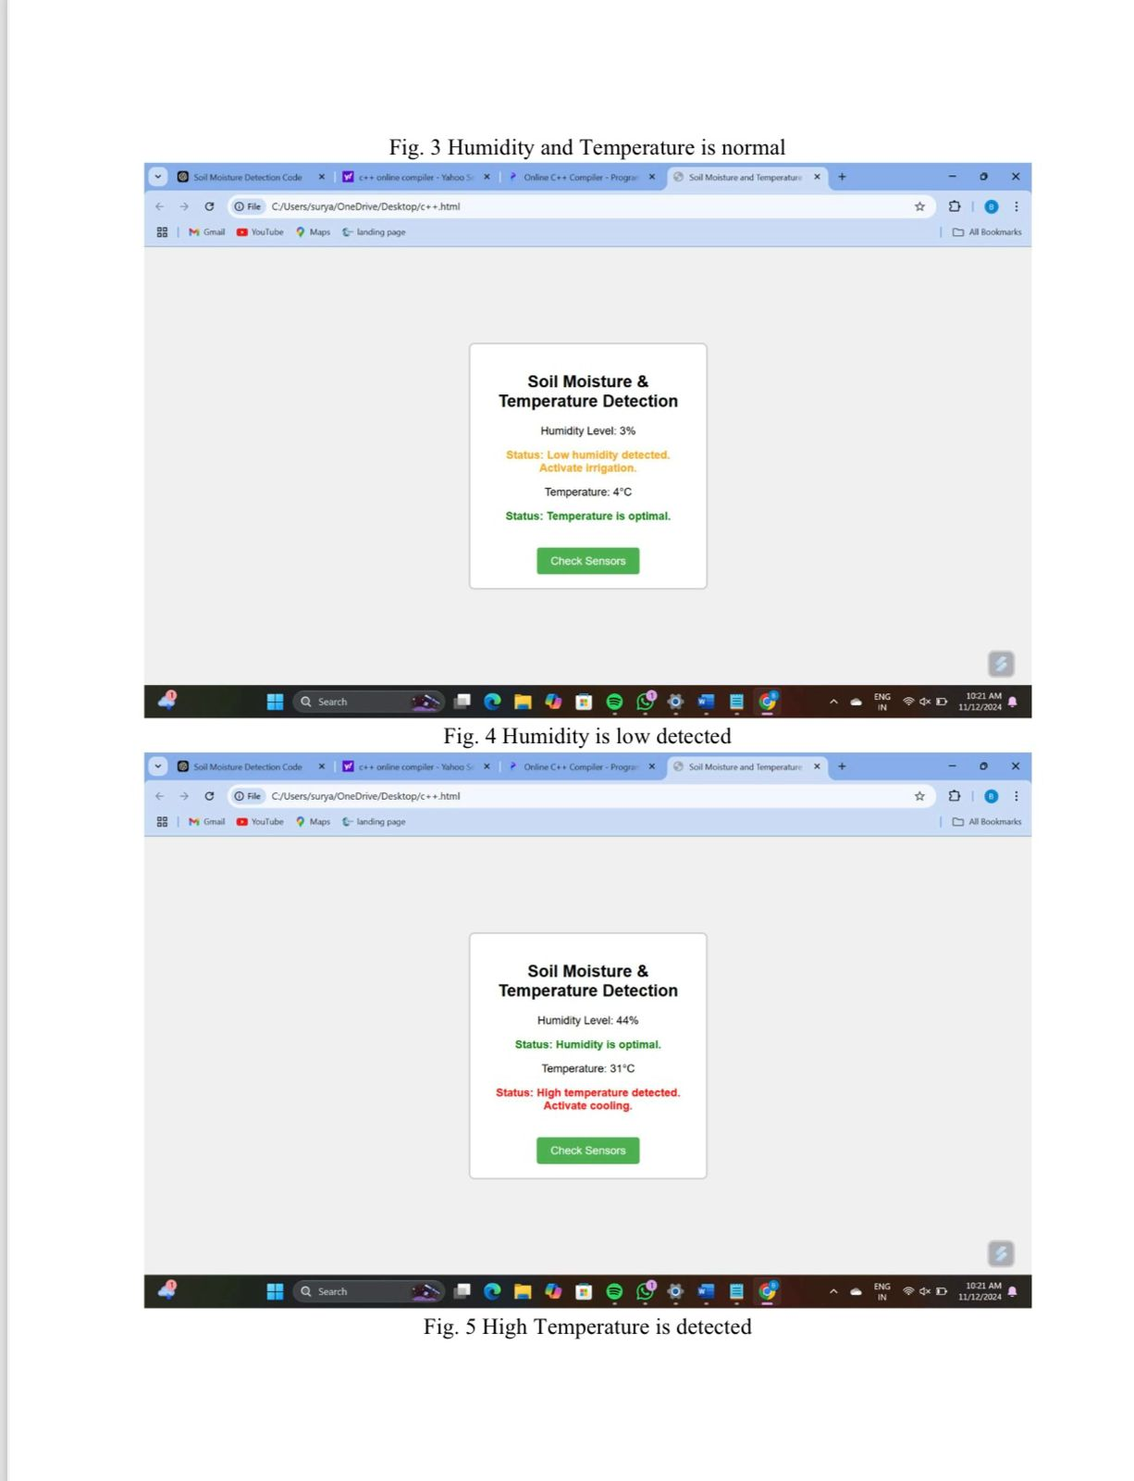
Result
In Fig 2:- we observe that in home page od the soil moisture detection system using raspberry pi . Fig3 After giving the input values by sensors humidity as 30 and then temperature as 20 it is optimal. Fig 4 After changing the values of humidity and temperature we can find change in humidity.

